Slide 1
Affordable Housing:
A Key Part of Upward Mobility
Tyler Berl, MA
Manager, Community Development & Advocacy
Notes:
Introduction – Tyler Berl, Manager of Community Development & Advocacy at Housing Alliance Delaware
Housing Alliance Delaware
Statewide nonprofit agency working to “advance housing opportunities, end homelessness, and promote vibrant communities” throughout Delaware.
How do we do this:
Coordinate with the stakeholders in the field to strategically plan for the growth of the sectors of homelessness and community development – Continuum of Care, Sussex Housing Group
Utilize research on the national and local housing sector manage data on the state’s homeless population to advance data-informed policy changes - CMIS
Technical assistance with nonprofits and communities to increase their capacity
Goals for the day:
Consider how place matters in our ability to advance in life – to participate in the “American Dream” of doing better than our parents did.
To help to understand how the quality of our environment, our access to public goods and areas of opportunity, to social capital all lead into determining if we will get ahead in life
To discuss some of the national and local policy decisions that got us to where we are today
Illuminate things that can be done to make it so we live in a more equitable society and increase upward mobility

Slide 2
Intergenerational Mobility Around the World
Source: World Bank Group, 2018. Fair Progress? Economic Mobility across Generations around the World. Washington, DC: World Bank.
Notes:
A global perspective
In a large majority of economies across the world, one’s chances of reaching the top quarter of the ladder of educational attainment depend largely on where one’s parents stood on that ladder. This share would be 0.25 if one’s ability to obtain an education did not depend on how well educated one’s parents are. However, there are very few economies in which the share exceeds 0.20. Among the bottom 50 economies by this share among the 1980s generation, 46 are developing, whereas only 4 are high income, including the United States.

Slide 3
Income Mobility in the U.S. since 1940
Source: Chetty et al., 2017. The fading American Dream: Trends in absolute income mobility since 1940.
Notes:
Research from Raj Chetty, and colleagues at Stanford University and Harvard University, and the research team at Harvard University Opportunity Insights.
Rates of “absolute income mobility” have fallen precipitously. In 1940, 92% of children grew up to earn more than their parents.
In 1984, only 50% of children earned more than their parents.
While largely not pertinent to this discussion here today, it is worth considering what is causing this reduction in income mobility at the country-wide scale:
Most of the decline in absolute income mobility can be attributed to two factors: lower Gross Domestic Product (GDP) growth rates; and, greater inequality in income distribution.
Research has also proven though that absolute mobility is not spread out across a county, state, or nation uniformly. Some areas have higher rates of mobility than others. PLACE MATTERS. Characteristics of high mobility areas:
Less residential segregation
Less income inequality
Better primary schools
Greater social capital
Greater family stability
These five variables explain 76% of the variance in upward mobility across areas.
Further research has shown moving children born in areas of less income mobility to areas of higher income mobility has significant positive effects. The incomes of children who move converge to the incomes of the permanent residents in the destination.
On average, spending an additional year in a community where the mean income is 1% higher increases a child’s income in adulthood by 4%.
Lesson – moving families to areas of opportunity is one strategy to spur upward economic mobility.

Slide 4
A segregated society: the role of public policy in the U.S. housing market
1933: Public Works Administration (PWA)
1933: Home Owners’ Loan Corporation (HOLC)
1934: Federal Housing Administration (FHA)
1944: GI Bill, VA Home Loan Guarantee Program
1956: National Interstate and Defense Highways Act
1968: Fair Housing Act
1974: Equal Credit Opportunity Act (ECOA)
Notes:
The PWA was a New Deal initiative of the Franklin Roosevelt administration
Goal – to alleviate the national housing shortage while creating jobs in construction
First major public housing development – creating 47 projects
Established the “neighborhood composition rule”:
Stating that, “federal housing projects should reflect the previous racial composition of their neighborhoods.”
Projects in white areas could only house whites, projects in black areas could only house blacks, projects could only be integrated if they were placed in an area that was already integrated.
Pattern though was to segregate projects even in areas where there wasn’t a previous history of segregation – and designated most neighborhoods as either white or black
Also concentrated African American projects in low income neighborhoods
HOLC sought to rescue households that were about to default by purchasing existing mortgages that were subject to foreclosure
Issuing new mortgages with longer loan periods
New mortgages were amortizing loans so households could gain equity while paying back the loan
Government sought to avoid the risk that any loan that they issued would be defaulted upon:
Hired local real estate agents to make appraisals on which refinancing decisions were risky based off the condition of the house and of the surrounding houses in the neighborhood to determine if the property would maintain its value
HOLC created color coded maps of every metropolitan area in the nation – with the safest areas in green and the riskiest areas in red
A neighborhood earned a red color if African Americans lived in it
HOLC did not always deny saving a home in a red colored neighborhood but it was the first example showing the federal government felt that African Americans were a poor risk.
FHA established to solve the inability of middle-class renters to purchase single family homes
FHA insured bank mortgages that covered 80% of the purchase price
Twenty year terms, and fully amortized loan
FHA required that the property being purchased was appraised for its risk
FHA appraisal standards included a whites-only requirement
Racial segregation now became the official policy of the federal government
Just 2% of the $120 billion in FHA loans distributed between 1934 and 1962 were given to nonwhite families
FHA’s biggest impact was not underwriting individual home mortgages, but entire subdivisions, as racially exclusive white enclaves (suburbs)
VA Home Loan Guarantee Program established after World War II
Insured mortgages for returning service man
Adopted FHA policies
By 1950, half of all mortgages where underwriten by FHA or the VA

Slide 5
A segregated society: the role of public policy in the U.S. housing market
“There shall bot be erected or maintained without the written consent of the party of the first part on said premises, any slaughter house, smith shop, forge furnace, steam engine, brass foundry, nail, iron or other foundry, any manufactory of gunpowder, glue, varnish, vitriol, or turpentine, or for the tanning dressing or preparing of skins, hides or leathers, or for carrying on any noxious, dangers or offensive trade; all toilet outhouses shall be suitably screened, no part of said premises shall be used for an insane, inebriate or other asylum, or cemetery or place of burial or for any structure other than a dwelling for people of the Caucasian Race.”
- New Jersey covenant, 1925
“The real property above described, or any portion thereof, shall never be occupied, used or resided on by any person not of the white or Caucasian race, except in the capacity of a servant or domestic employed thereon as such by a white Caucasian owner, tenant or occupant.”
- California covenant, 1950
Notes:
In 1910 Baltimore became the first city to use racial zoning to prohibit African Americans from buying property on blocks where white families lived.
In 1917 the Supreme Court ruled that racial zoning infringed upon the 14th amendment right – not for equal access of African Americans – but of the right of business owners to enter into contract to sell to whomever they wanted
Buchanan v. Warley
Following the Buchanan decision segregationists had two problems –
How to keep lower-income African American families living near middle-class whites
How to keep middle class African Americans from buying into middle class white neighborhoods
In the 1910’s local governments started promoting zoning ordinances to reserve middle class neighborhoods for single family homes, which low income families could not afford – multifamily units prohibited
Used zoning codes to degrade African American communities
Zoned for industry and sin businesses (casinos)
Allowed properties to be subdivided – promoted single room occupancy/flop houses
Racial covenants – prohibiting the sale or rental of housing to specific races.
Stricken by the Supreme Court in 1948 Shelley v. Kramer
Additional local actions that have been taken:
Denial of access to public utilities
Rezoning properties of interest for housing to African American communities and households as parklands
Routing interstates in between communities to bifurcate neighborhoods
Choosing school sites to force families to move to a segregated community if they wanted their children to go to school
Rezoning or condemning properties
Charging African American neighborhoods higher property tax rates

Slide 6
A segregated society: race & income in the U.S.
Source: Harvard University, Joint Center for Housing Studies, 2017. Fostering Inclusion in American Neighborhoods.
Notes:
Race and income segregation are highly correlated.
Segregation measures – dissimilarity index: what percent of households in each group would have to move in order to achieve an even distribution across neighborhoods
Residential segregation has declined since the Fair Housing Act of 1968 but remains at levels higher than at the beginning of the 1900s
Residential segregation peaked in 1970
In 2010 –
black-white dissimilarity index was 59%
White-Hispanic – 49%
Asian-white – 41%
Income segregation has steadily risen in all levels of income distribution
Segregation of poverty
Segregation of affluence and opportunity hoarding
Cost of segregation on individuals and society disproportionately felt by minority and low-income communities.
Educational Outcomes
One-fourth of the black-white SAT gap can be attributed to racial residential segregation
Youth who grow up in high-poverty neighborhoods perform worse in schools, are more likely to drop out of high school, and are less likely to go to college
Kids who spend longer living in high-poverty neighborhoods have worse education outcomes
Economic opportunity
Employment opportunities have been shown to be worse for minorities living in highly segregated metro areas
Access to credit, power, and social capital
Health and wellbeing
Neighborhoods with concentrated disadvantage have detrimental influence of adult and infant mortality, physical and mental health of children and adults, and health behaviors
Perception of danger leads to greater levels of anxiety, depression, and other mental health disorders
Long-term effects makes residents in segregated communities more vulnerable to disease
Less access to nutrition and affordable food, green space and physical activity, medical care
Disproportionately likely to host environmental hazards: poor air quality, elevated levels of toxins

Slide 7
United States Racial-Wealth Gap
Notes:
Institute on Assets and Social Policy used a subset of the Panel Study of Income Dynamics to track 1,700 working-age households from 1984-2009
Drivers of racial wealth gap:
Number of years of homeownership (27% of the difference in relative wealth growth between white and African American families)
Average family income (20%)
Unemployment (9%)
College education (5%) – similar college degrees produce more wealth for whites
Inheritance and financial support from family (5%)

Slide 8
Wealth in America: The U.S. Homeownership Gap
Notes:
IASP – Why does, as a whole, home equity rise so much more for whites than African American households

Slide 9
United States Homeownership Gap
Source: Center for American Progress, 2019. Systematic Inequality: Displacement, Exclusion, and Segregation.

Slide 10
Housing Values in U.S. African American Communities
Source: Brookings Institute, 2018. The Devaluation of Assets in Black Neighborhoods.
Notes:
One particularly pernicious piece of the racial wealth gap – is the valuation of housing assets in African American communities
Research shows that homes in neighborhoods where the share of the population is 50%, or more, African American, home values are roughly half the price as homes in neighborhoods with no black residents
Difference in home values can not be fully statistically explained by differences in the home or the neighborhood’s quality
Across all majority black neighborhoods, owner-occupied homes are undervalued by $48,000 per house, on average,
Amounting to $156 billion in cumulative loss to homeowners in majority African American communities
Impact:
Black home owners realize less wealth accumulation, which makes it more difficult to start and invest in businesses and afford college tuition

Slide 11
United States Housing Affordability
Source: Harvard University, Joint Center for Housing Studies, 2019. Documenting the Long-Run Decline in Low-Cost Rental Units in the US by State
Notes:
Rising prices in the housing market:
Increasing demand for housing along with reduced levels of housing production, has contributed to staggering increases in rental and purchase prices of housing
Land use and zoning, artificially inflating the market by restricting the type and number of units available on a piece of property
Minimum lot sizes
Density restrictions
Government fees and regulations
Impact - Cost burden:
In 1990, 76% of low-income renters were cost-burdened – by 2017 this share had risen to 82%
One cause of this is the rental housing units market:
Between 1990 and 2017, the number of units renting for $600 or less, inflation adjusted, has declined by 4.0 million units
During this same period the overall rental stock grew sharply – by 10.9 million units
Steepest decline in affordable rental units happened in the period between 2012-2017

Slide 12
Place Matters: Upward Mobility in Sussex County
Source: Opportunity Insights, Harvard University, Opportunity Atlas
Notes:
Analysis of Impediments to Fair Housing Choice:
Delaware’s non-entitlement areas (including Sussex and Kent County) are considered “low segregation” when we look at Dissimilarity Index (anything below 40.0 score)
Segregation rising
Startling trend though:
1990 – non-white/white dissimilarity index – 20.35
2019 – 34.12
Moderate Segregation is considered a score of 4-54

Slide 13
Place Matters: Upward Mobility in Sussex County
Source: Opportunity Insights, Harvard University, Opportunity Atlas
Notes:
Rise in

Slide 14
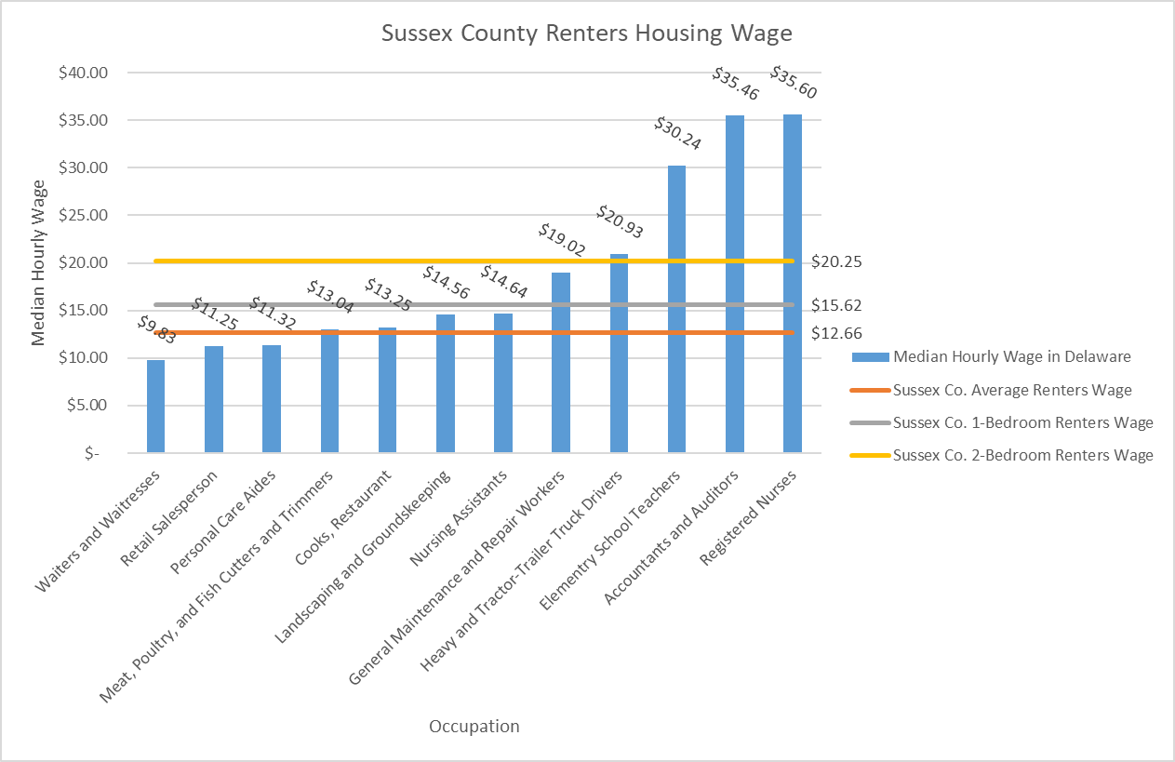
Sussex County Social Mobility Measures: Housing Costs
Source: Housing Alliance Delaware, 2019. State of Housing in the First State, 2019.
Notes:
On average, a renter household in Sussex County must earn $20.35 per hour to afford a two-bedroom rental unit and not spend more than 30% of their monthly income on housing expenses. While Sussex County’s 2019 rental housing wage was slightly lower than Delaware as a whole ($21.97), the county saw a drastic 17% increase from 2018, when the rate was $17.31.

Slide 15
Sussex County Social Mobility Measures:
Housing Cost Burden
Housing Cost Burden
Housing & Transportation Cost Burden
Source: Sussex County, 2019. Housing Need + Market Analysis
Source: Sussex County, 2019. Housing Need + Market Analysis
Notes:
Due to Sussex County’s limited supply of affordable and available housing units 16,210 homeowners (25.7% of Sussex homeowners) are cost burdened, spending more than 30% of their monthly income on housing expenses; of those, 6,925 spend more than 50% of their income on housing. The problem is worse for Sussex County renter-households, where 7,460 (41% of all renters) are cost burdened, of which 3,720 households utilize over 50% of their income on housing.

Slide 16
Sussex County Social Mobility Measures: Access to Credit
Source: Delaware Statewide Fair Housing Consortium, 2019. Analysis of Impediments to Fair Housing Choice,

Slide 17
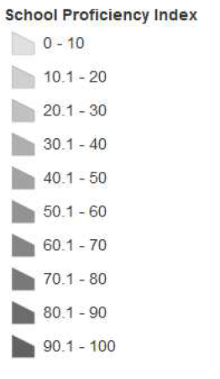
Sussex County Social Mobility Measures: School Proficiency
Source: Delaware Statewide Fair Housing Consortium, 2019. Analysis of Impediments to Fair Housing Choice,

Slide 18
Sussex County Social Mobility Measures:
Public Housing – Project-based Section 8
Source: Opportunity Insights, Harvard University, Opportunity Atlas
Source: Delaware Statewide Fair Housing Consortium, 2019. Analysis of Impediments to Fair Housing Choice,
Notes:
Sussex County’s share of publicly supported housing, as compared to its total number of housing units, is substantively smaller than Delaware as a whole, and in most cases, that of any other county. Sussex County’s 1,349 publicly supported housing units represents 1.09% of the county’s housing stock; the state has a total of 12,912 publicly supported housing units, or 3.18% of the state’s housing stock.

Slide 19
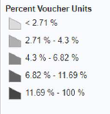
Sussex County Social Mobility Measures:
Public Housing – Housing Choice Vouchers
Source: Opportunity Insights, Harvard University, Opportunity Atlas
Source: Delaware Statewide Fair Housing Consortium, 2019. Analysis of Impediments to Fair Housing Choice,

Slide 20
Sussex County Social Mobility Measures:
Public Housing – Low Income Housing Tax Credit
Source: Opportunity Insights, Harvard University, Opportunity Atlas
Source: Delaware Statewide Fair Housing Consortium, 2019. Analysis of Impediments to Fair Housing Choice,

Slide 21
What can Sussex County do to promote upward mobility?
Private residents and businesses:
Support efforts to improve understanding of racial prejudice
Invest in neighborhoods with concentrated poverty
Local and County administration:
Modify zoning codes to encourage affordable housing in growth and opportunity areas
Establish a local Housing Trust Fund/preserve the existing supply of affordable housing
Inclusionary zoning
Waive or reduce fees for nonprofit and/or affordable housing development
Right to Counsel
At the state level:
Source of income protection
Prioritize public housing funds (CDBG, HOME, LIHTC) for multi-family development in high-opportunity areas – increase set asides and competitive points in application
Increase the supply of housing choice vouchers
Creation of mobility counseling for voucher holders
Right to Counsel
Cap on private criminal background screenings
Enforcement of anti-discrimination laws
Notes:
Currently only 5.86% of Sussex County land is zoned for multifamily housing, or is allowed through conditional use

Slide 22
Questions?
Thank you!
Tyler Berl, MA
tberl@housingalliancede.org
(302) 654-0126 ext. 111

