Slide 1
Multitalented and Multicultural: How to Harness the Power of Sussex County’s Growing Diversity
Patricia V. Rivera Hook PR & Marketing

Slide 2
25 years

Slide 3
The change
Sussex population: 1990-2016
 | 1990 | % | 2016 | % | % Change
Total | 113,229 | 100% | 211,224 | 100.0% | 86.5%
White | 92,395 | 81.60% | 176,692 | 83.7% | 91.2%
Black | 18,995 | 16.80% | 29,340 | 13.9% | 54.4%
Hispanic or Latino (Any Race) | 1,476 | 1.30% | 19,424 | 9.2% | 1,215.5%
Asian | 589 | 0.50% | 3,156 | 1.5% | 435.8%
Hawaiian or Pacific Isl. | 28 | 0.50% | 240 | 0.1% | 757.1%
Am. Indian or Native Alaskan | 645 | 0.60% | 2,254 | 1.1% | 249.5%
Other | 605 | 0.50% | 4,462 | 2.1% | 637.5%
Totals exceed 100 percent because Hispanic or Latino can be any race.

Slide 4
The change
Percentage change: 1990-2016
Total | 86.5%
White | 91.2%
Black | 54.4%
Hispanic or Latino (Any Race) | 1,215.5%
Asian | 435.8%
Hawaiian or Pacific Isl. | 757.1%
Am. Indian or Native Alaskan | 249.5%
Other | 637.5%

Slide 5
The change
Sussex population: 1990-2016

Slide 6
The change
Hispanic-owned businesses
Rose from 383 in 2007 to 800 in 2012 in Sussex.
Construction 199
Retail Trade 100
Transportation 43
Admin. Support & Waste Mgt. 135
Healthcare and Social Asst. 46
Accommodation and Food Service 52
Other Services 70

Slide 7
The change
Median age: 1990-2016
Total | 1990 | 2016
White | 38.4 | 47.6
Black | 28.2 | 50.7
Hispanic or Latino | 24.7 | 34.6
Asian | 31.4 | 24.9

Slide 8
The change
Growth in number of retirees
The population of people over age 65 is expected to reach 80,000 in 2030 — almost double what it was in 2010.

Slide 9
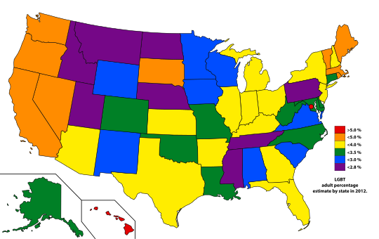
The change
LGBT community growth
2000-2010 Household Couple Growth
41.65% Increase
Decennial Census Data on Same Sex Couples. U.S. Census Bureau.

Slide 10
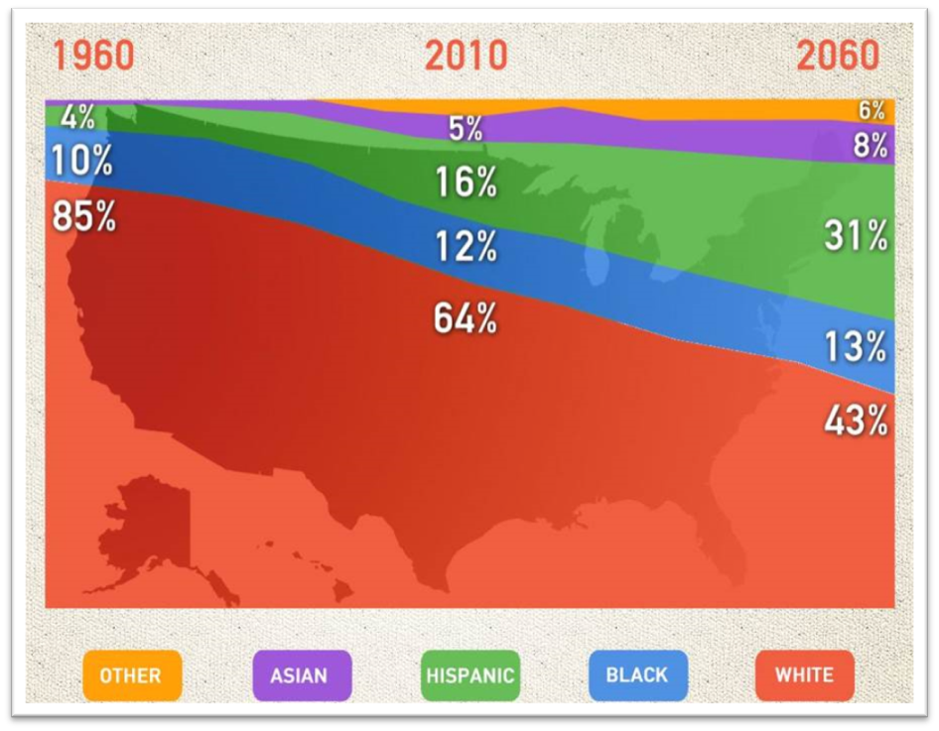
The new majority
National shift in demographics
Source: Pew Research Center & NBC Nightly News

Slide 11
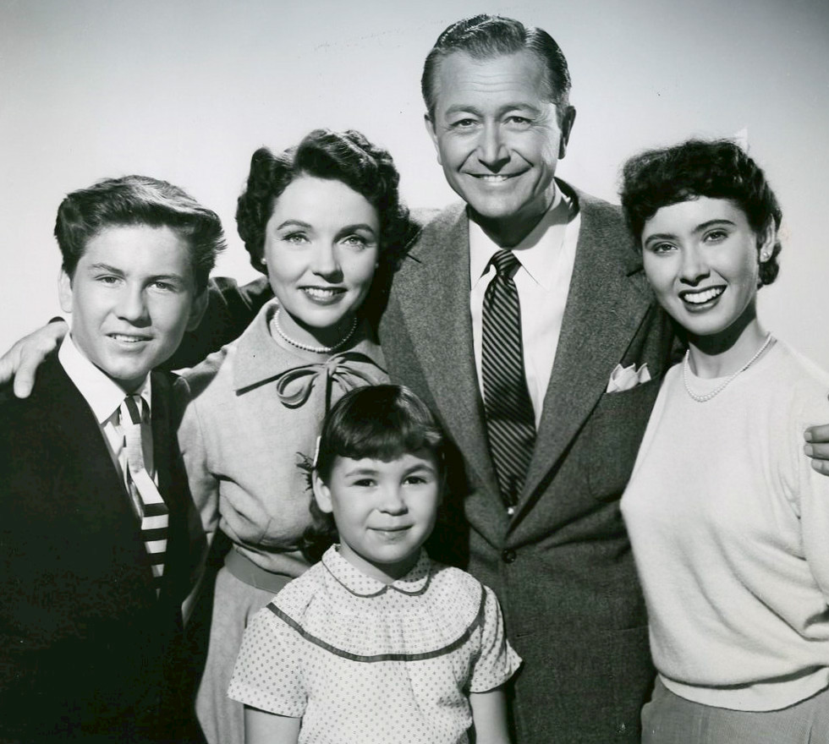
The old majority

Slide 12
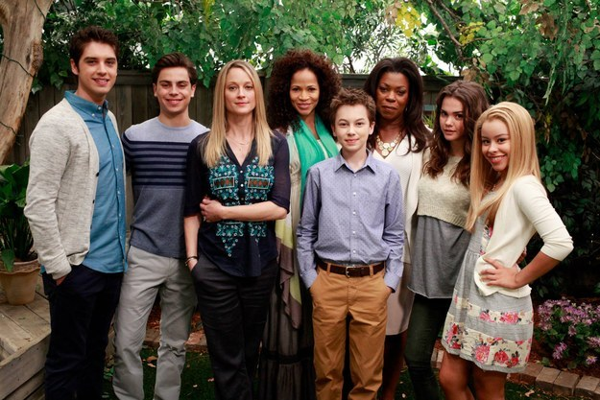
The new majority
Our messages must speak to African-Americans, Latinos, Asian-Americans, and the lesbian, gay, bisexual and transgender (LGBT) community — also known as the New Majority.

Slide 13
The new majority
Multicultural: Marketing that targets clearly defined ethnic groups, such as Hispanics, African-Americans, Koreans, etc. Separate but distinct.
Total Market Approach: Marketing designed to reach all consumers, across general and ethnic markets.
A total market strategy asks us to integrate all of these segments into a meaningful message that appeals to all while appreciating cultural nuances.

Slide 14
Embracing diversity
Semantics aside, it’s about developing more thoughtful conversations.

Slide 15
Embracing diversity
1. Study diverse communities
Research the communities in Sussex County and Delaware and identify their needs. The better you understand someone, the better you can market to him or her.
Get past misperceptions and stereotypes.

Slide 16
Embracing diversity
To succeed with marketing, you need to understand:
Place of origin
Age
Language preference
Interests
Challenges and needs
Goals and aspirations
Shared values

Slide 17
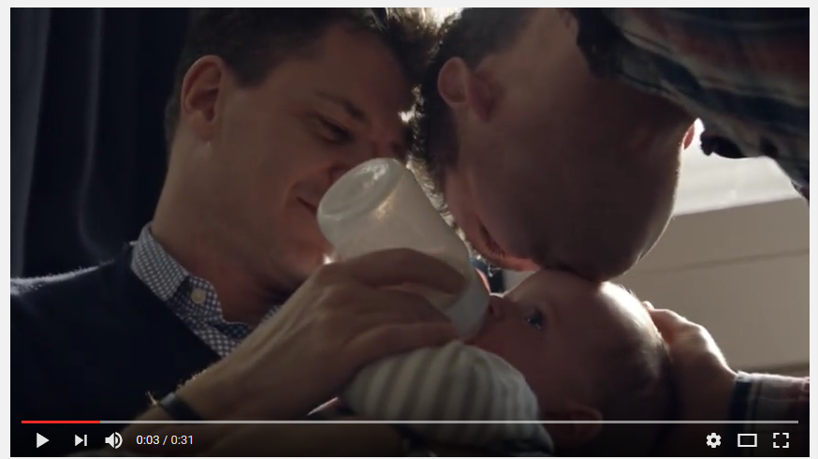
Embracing diversity
2. Embrace universal truths.

Slide 18
Embracing diversity
Universals bind us and help us make sense of the world by making connections. We appreciate how others overcome the challenges in their lives.

Slide 19
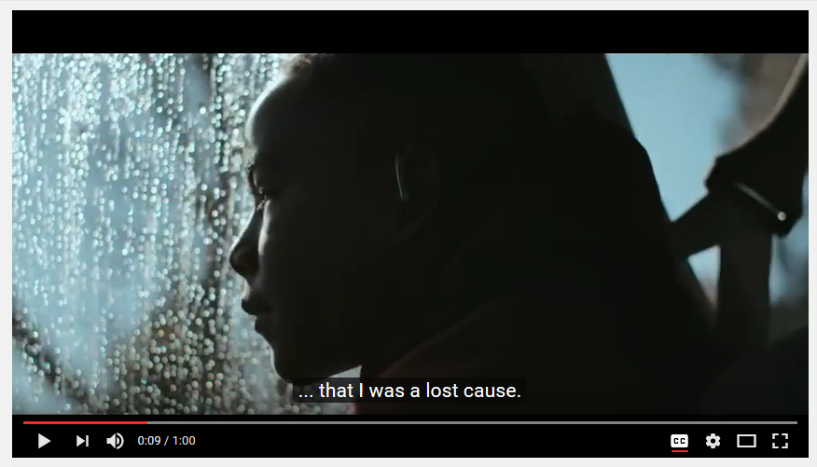
Embracing diversity
Duracel’s new tagline, “Trust the power within,” leads to stories about people who have overcome adversity, including NFL player Derrick Coleman.

Slide 20
Embracing diversity
Beating the odds
Coming of age
Fear of failure
Need for change
Parent-child bond
Power of the mind
Price of progress
Road not taken
Quest for knowledge
Will to survive

Slide 21
Embracing diversity
3. Be willing to take a stand
You’re never going to please everyone. You can:
Do your research
Show a genuine interest in people from other cultures
Engage in dialogue
Be transparent

Slide 22
Embracing diversity
Take a position and embrace individuals and families who don’t look like you and who have a followed a very different journey.
Ask: Do #WeAccept?

Slide 23
25 Years
Let’s connect
135 Second Street, 2nd Floor in Lewes
patricia@hookpr.com
302 858 5055
@hookprgroup on Facebook and Twitter
linkedin.com/in/riverapatricia
www.hookpr.com

Slide 24
Thank You

