Slide 2
O U R C O M P A N Y

Slide 3
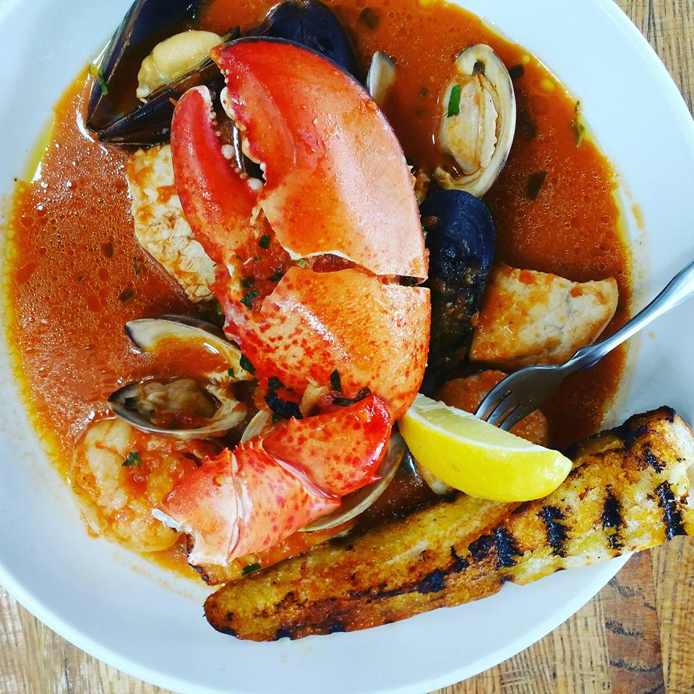
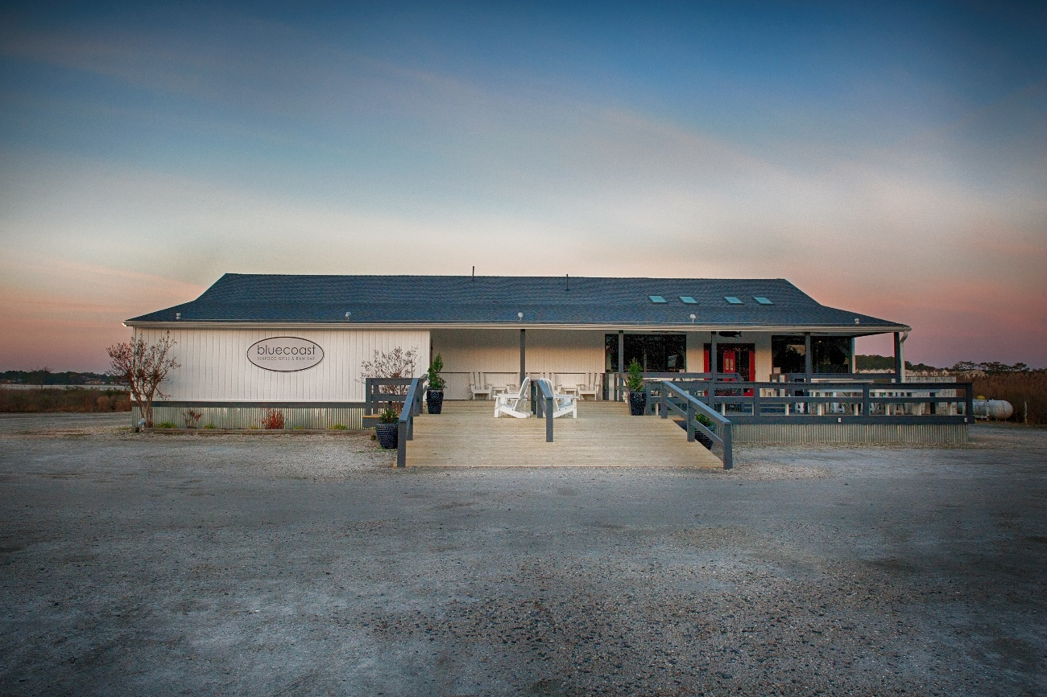

Slide 4
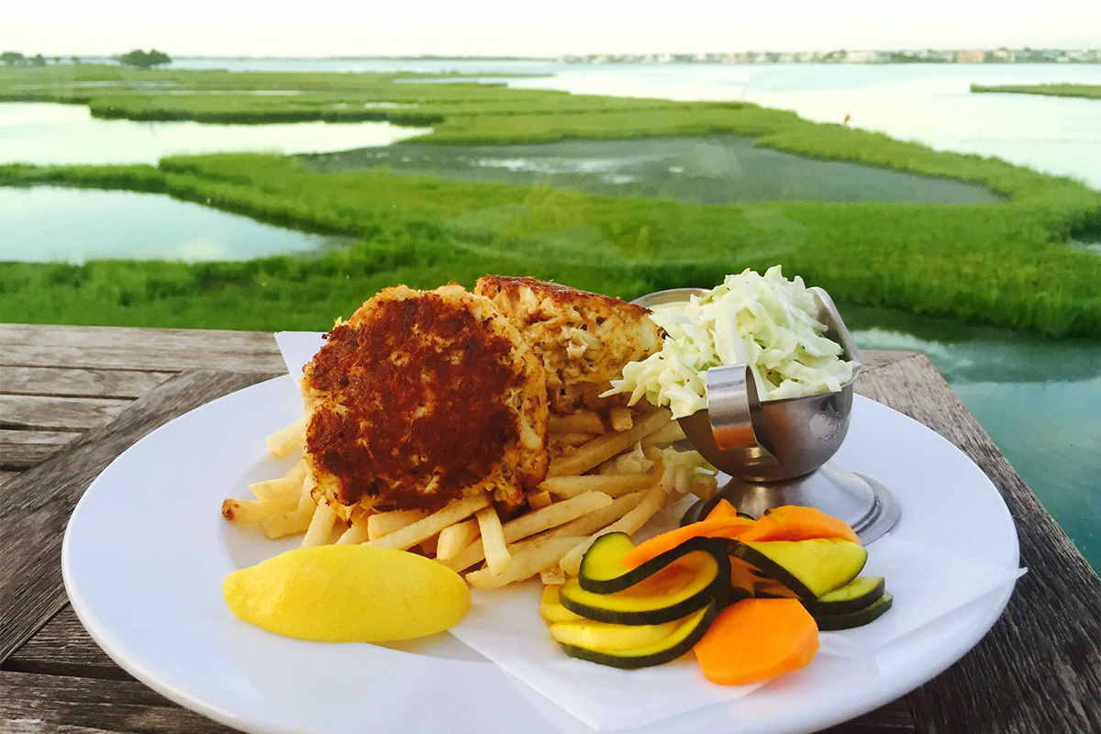
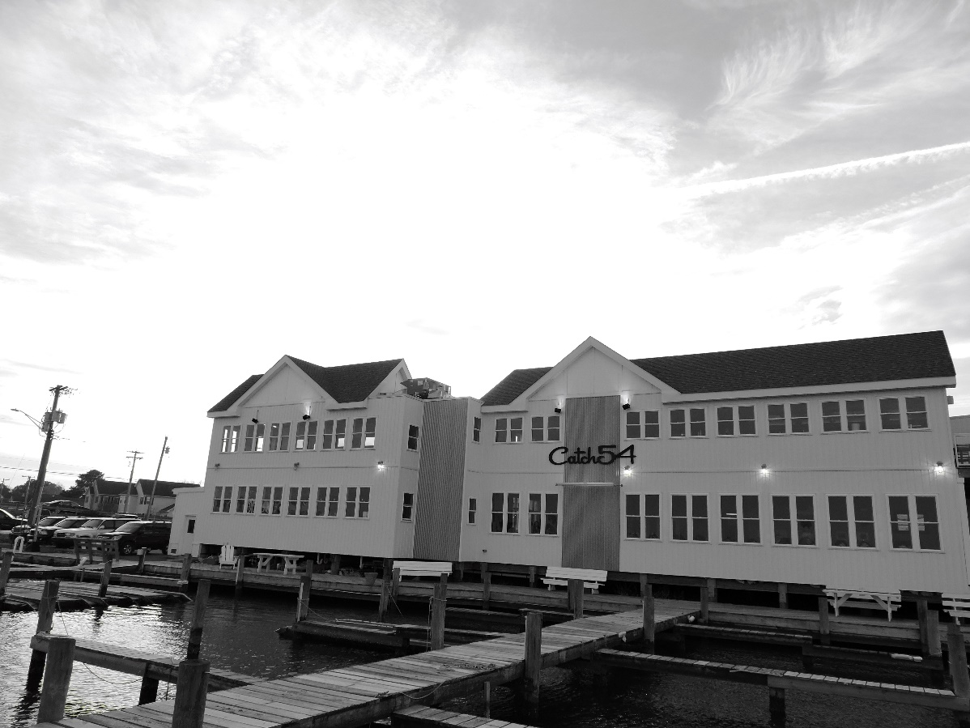

Slide 5
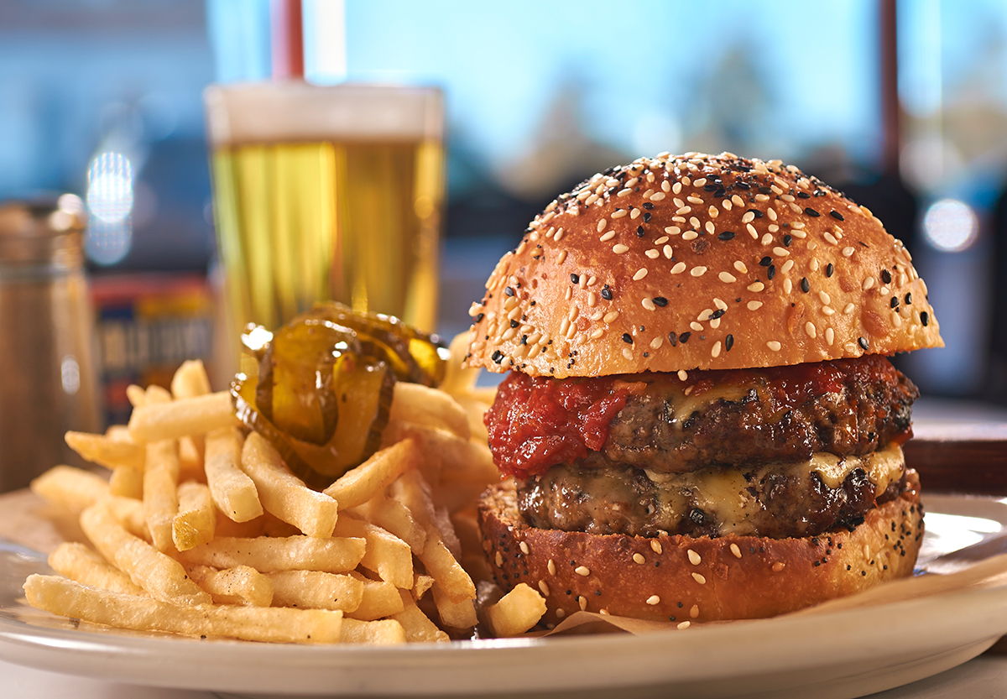
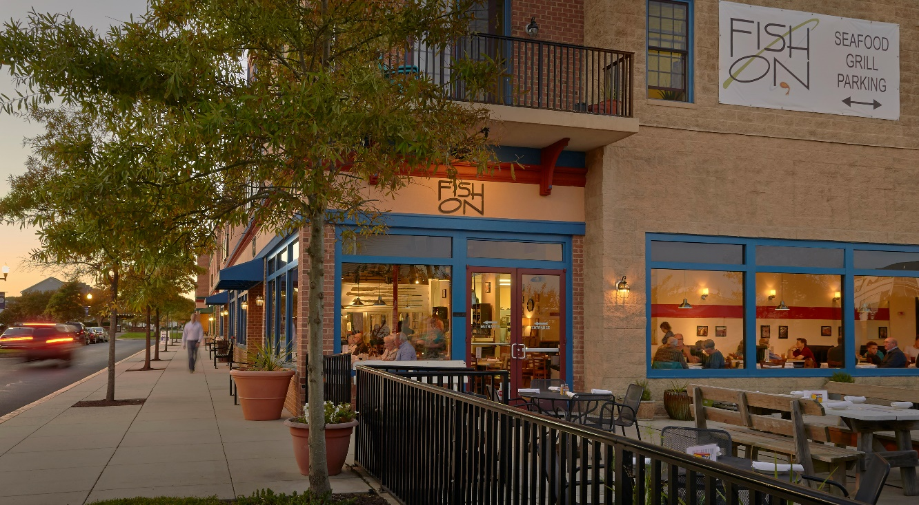

Slide 6
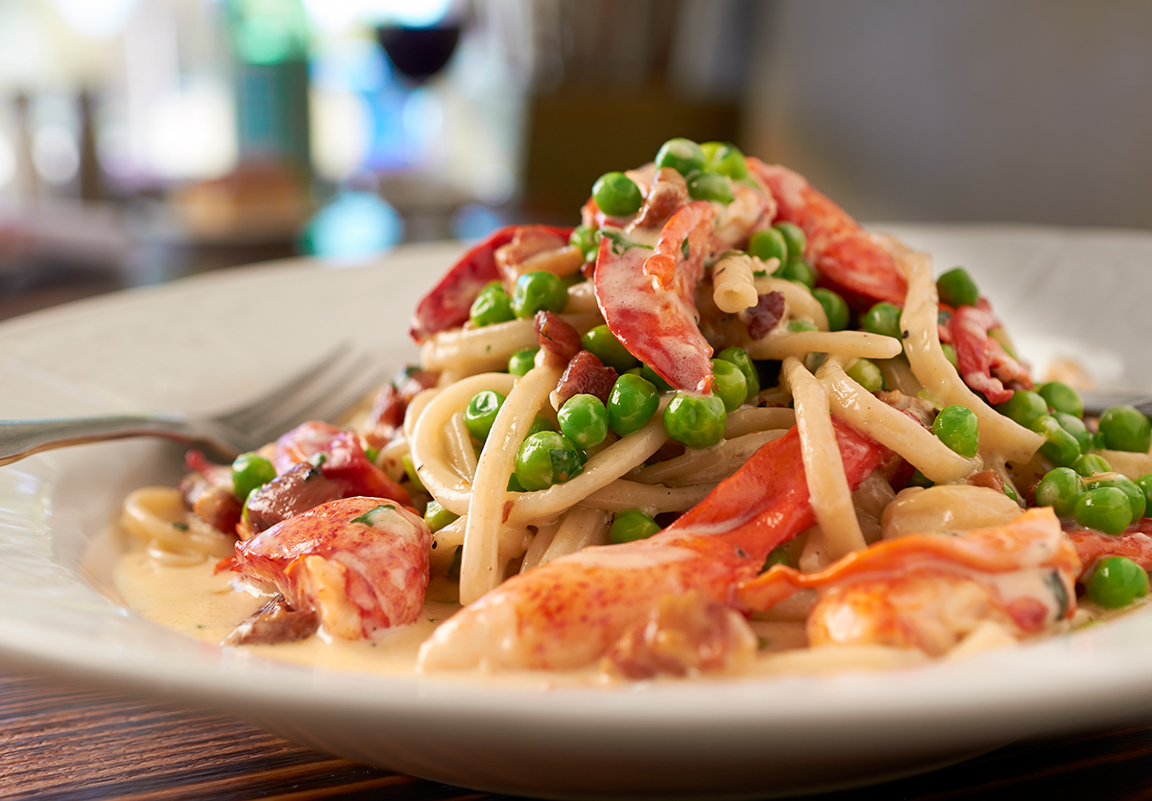
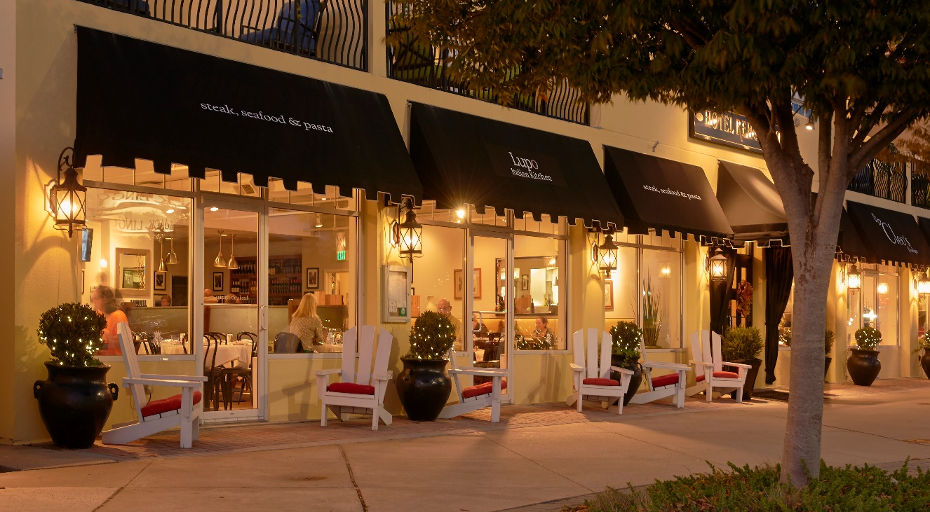

Slide 7
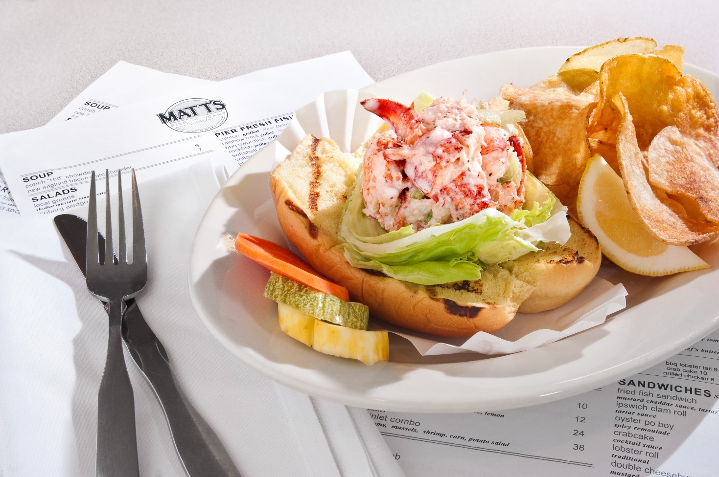
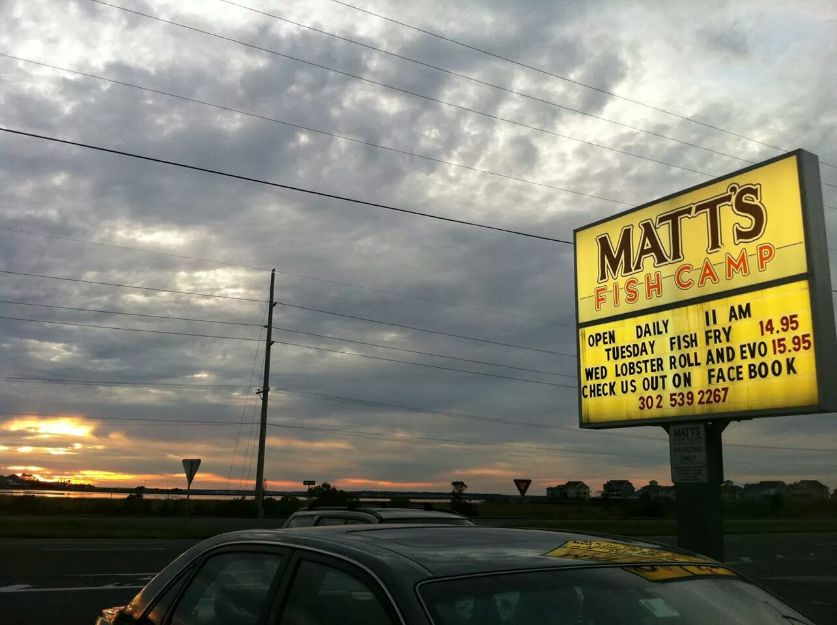

Slide 8
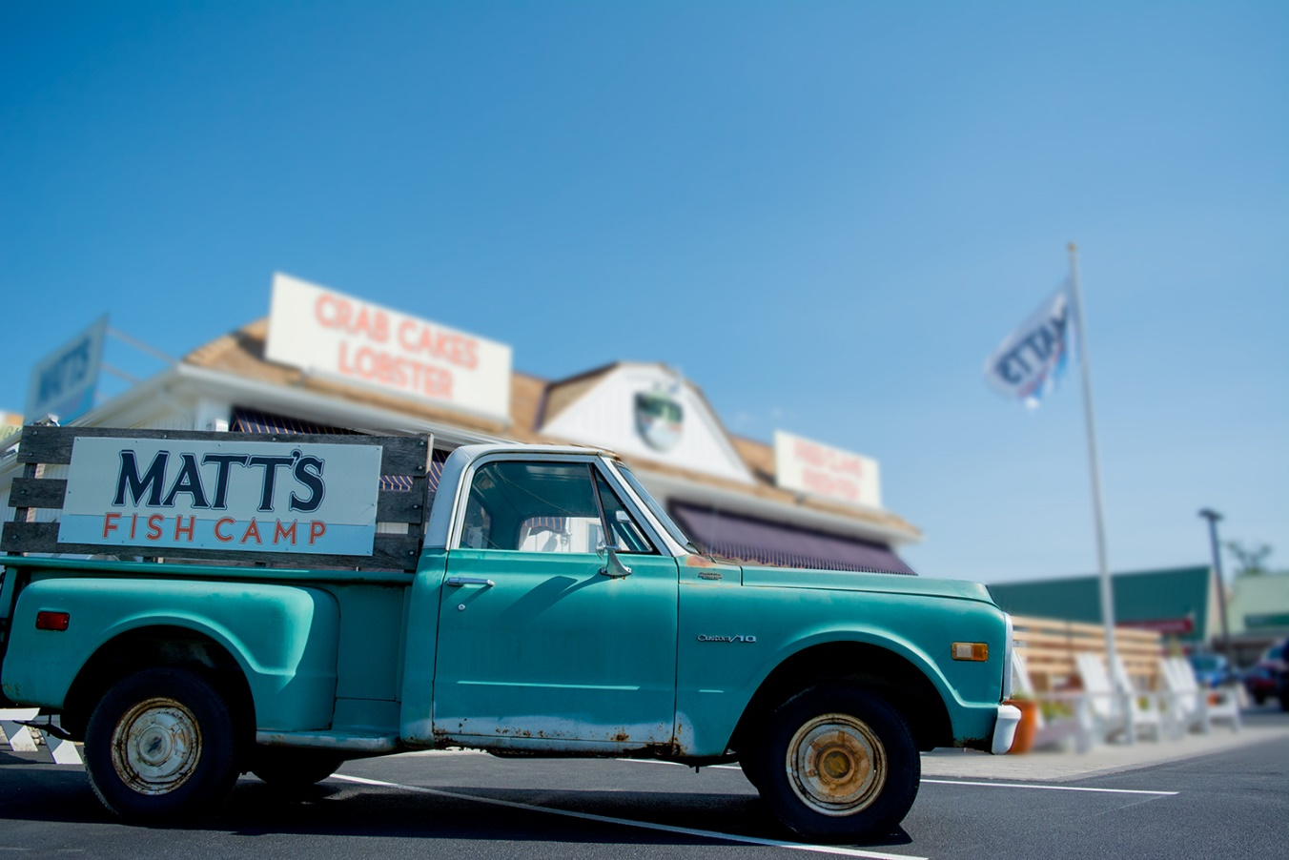
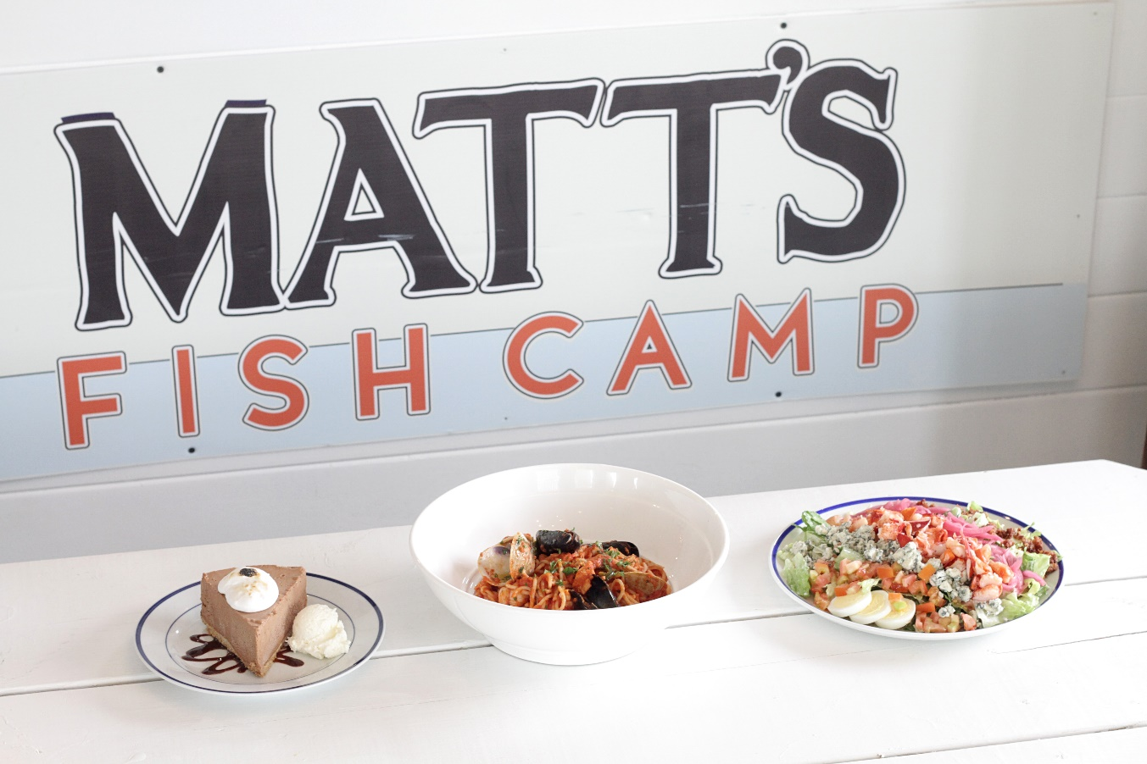

Slide 9
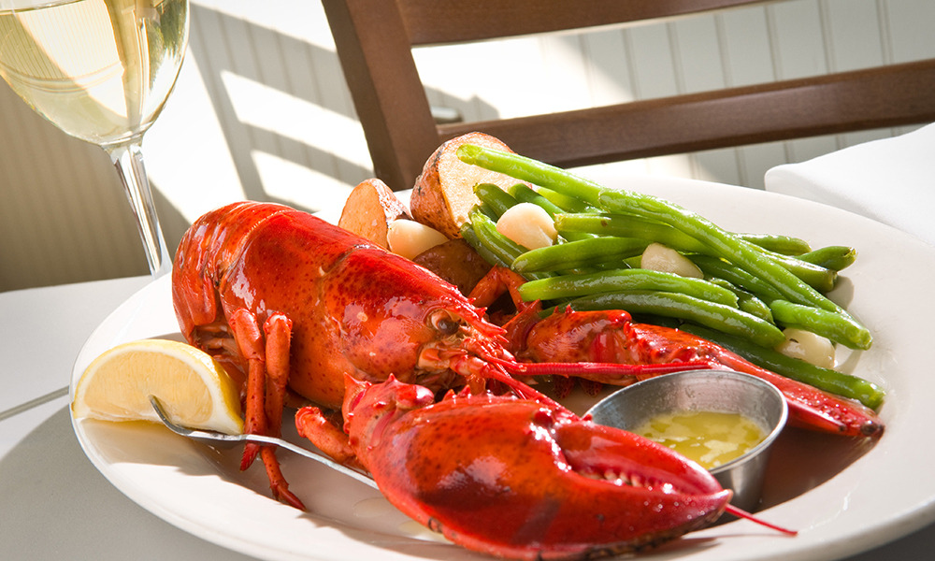
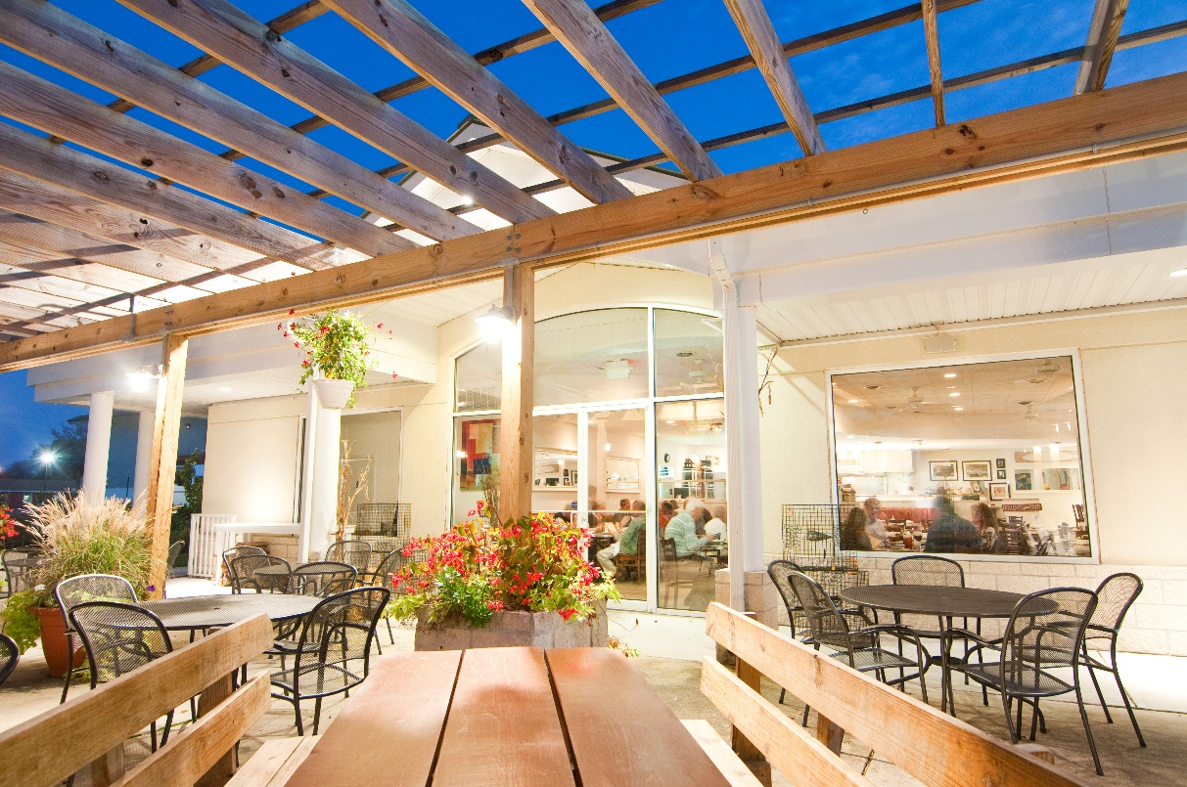

Slide 10
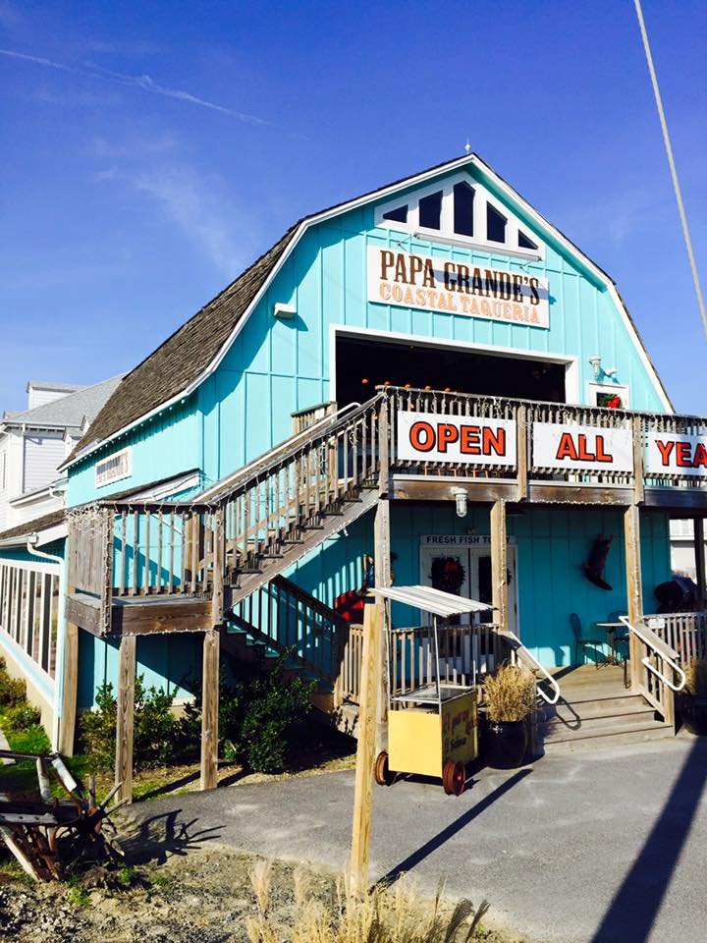
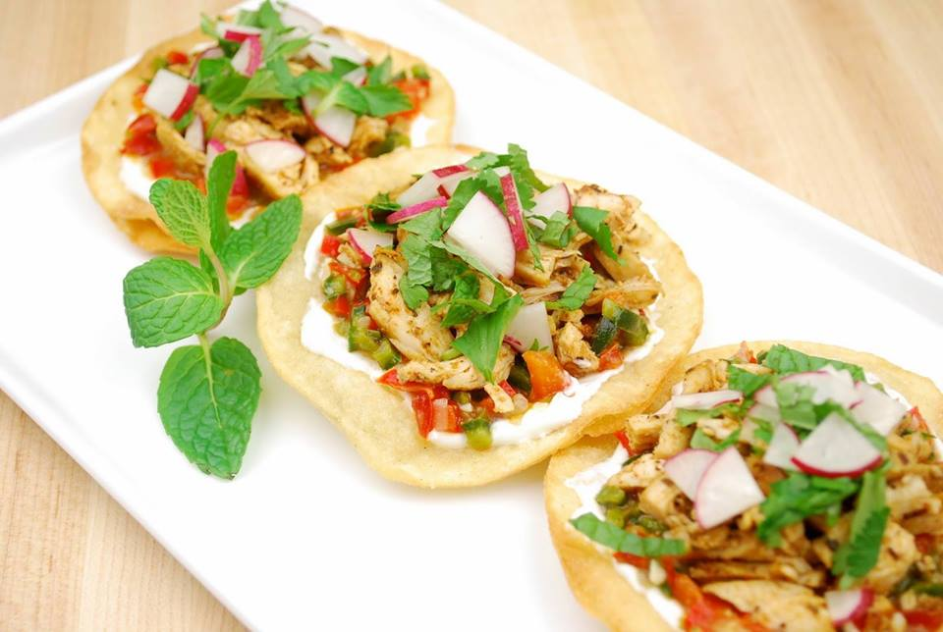

Slide 11
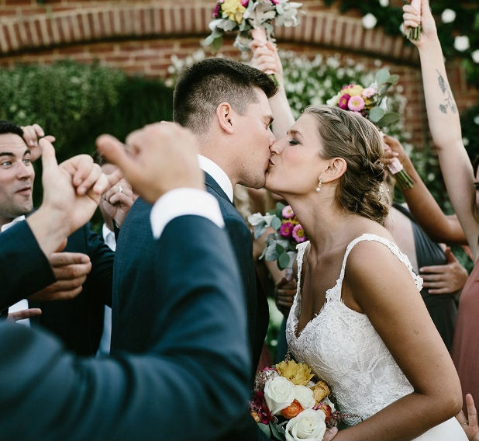
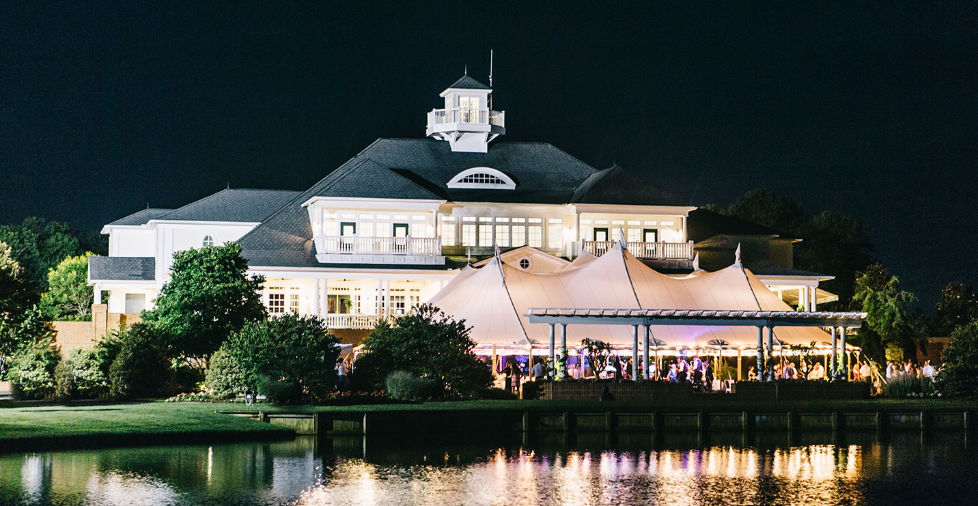

Slide 12
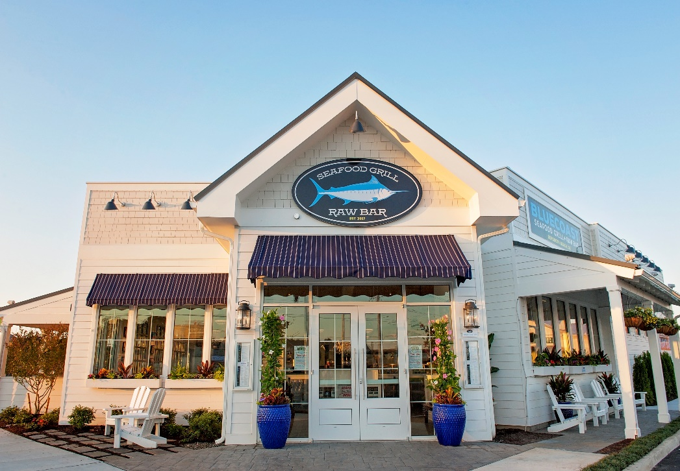

Slide 13
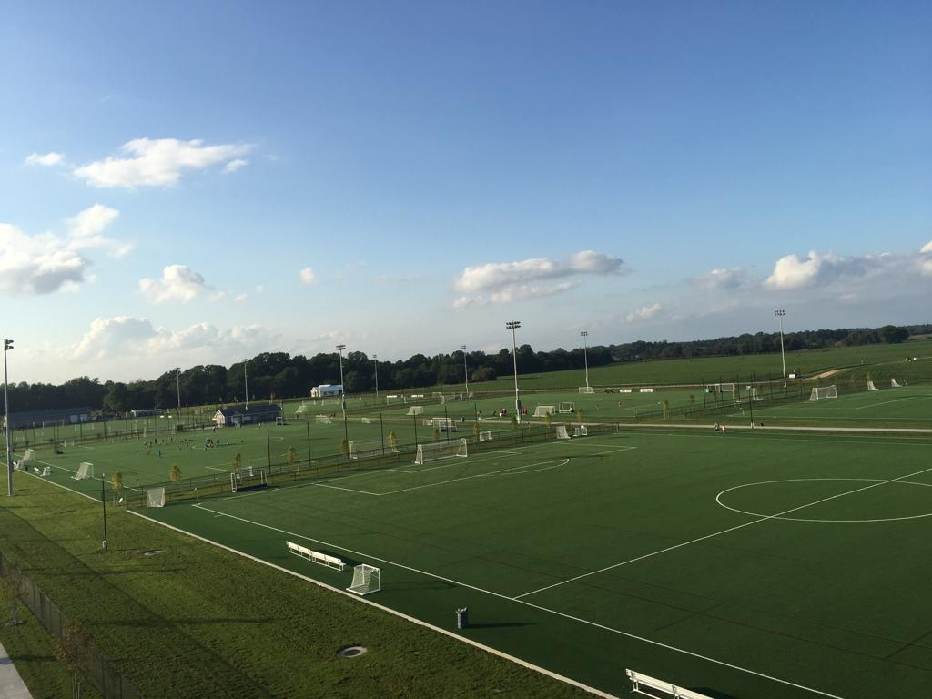
Providing food service to the two premiere sporting event venues in Delaware, DE Turf and Sports at the Beach.

Slide 15
W H A T ‘S H A P P E N I N G N O W

Slide 16
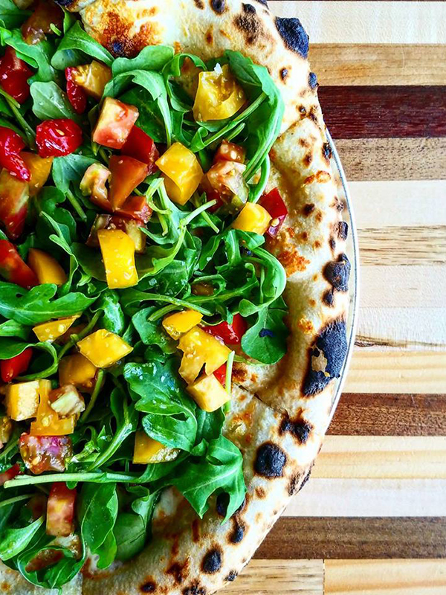
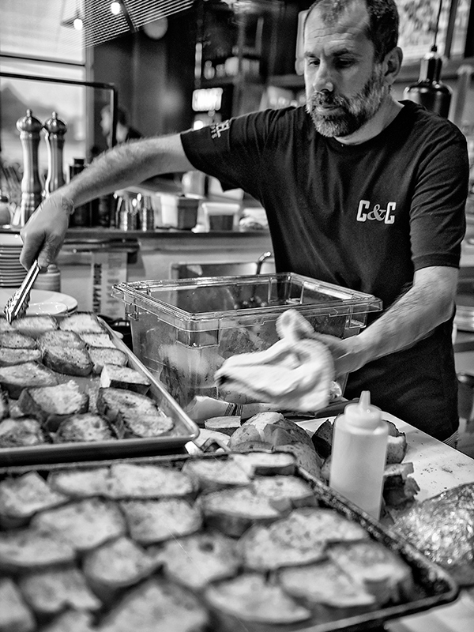
Crust & Craft

Slide 17
NEW VENTURES

Slide 18
WORKING THE MONSTER MILE SERVING THE MASSES

Slide 20
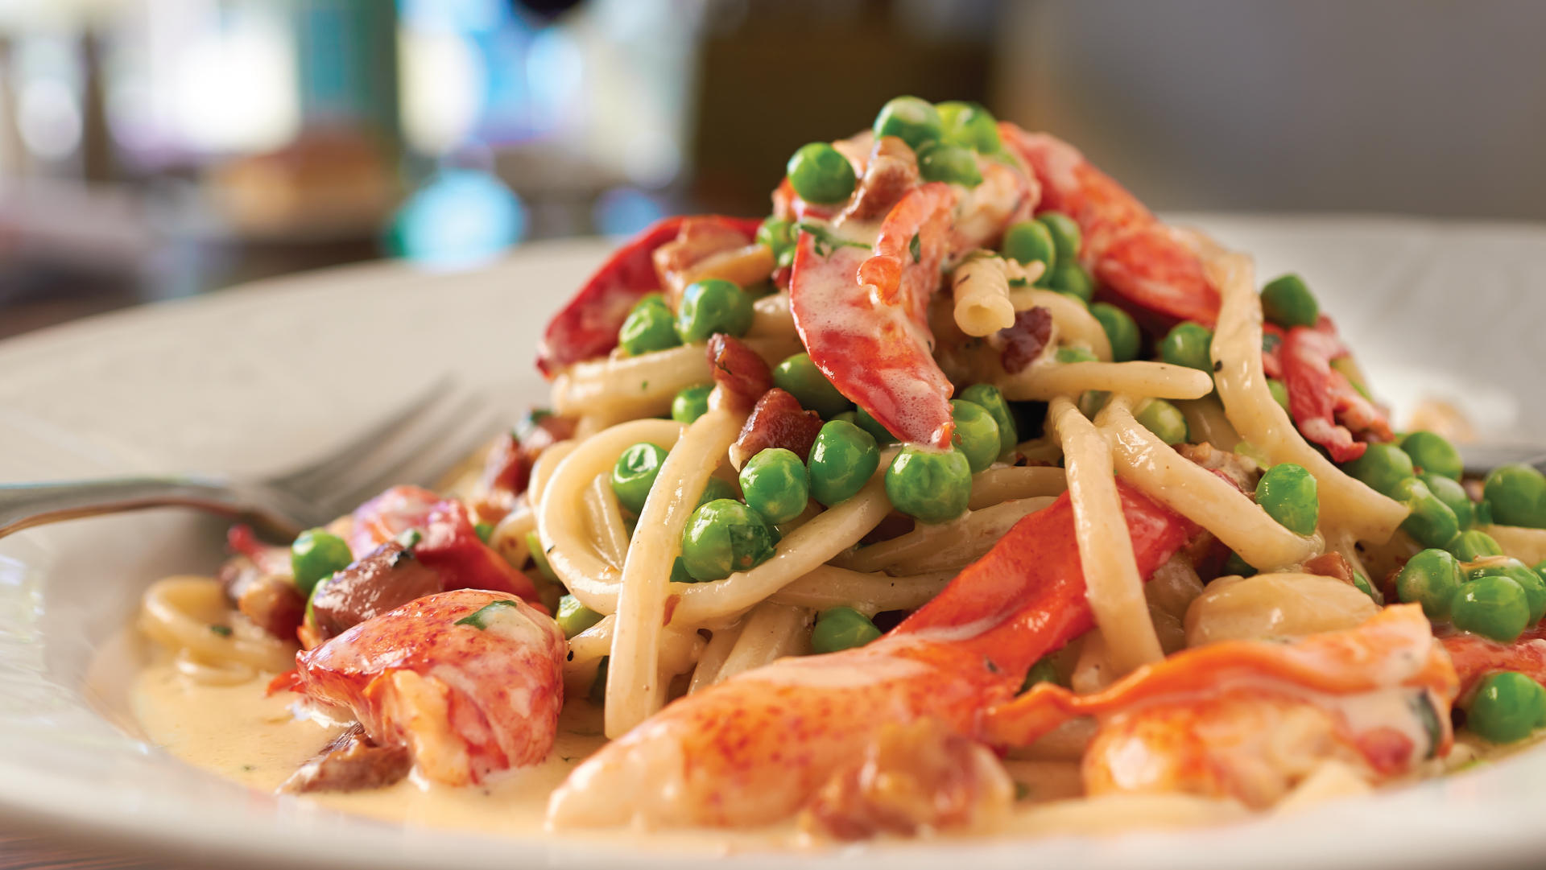

Slide 22
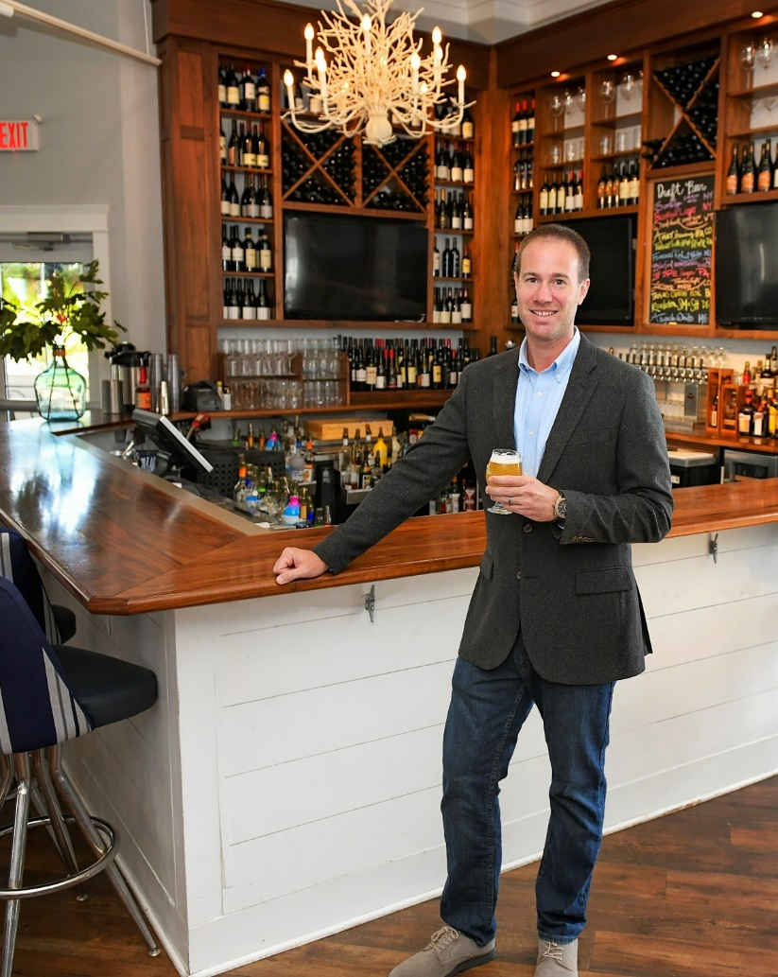
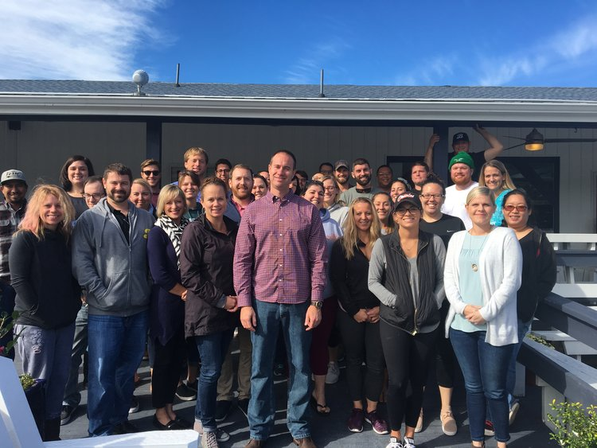
SoDel Concepts’ Matt Patton receives cicerone certification
SoDel Concepts’ Matt Patton recently received his cicerone certification.
The term — pronounced “sis-uh-rohn” — refers to hospitality professionals with proven experience in selecting, acquiring and serving a wide range of beers.
In Delaware, Patton, the beer director for Rehoboth Beach-based SoDel Concepts, is one of the only certified cicerone in the restaurant industry and one of five in the state.
To earn the certification, candidates must know how to keep and serve beer. They must also know about the many styles of beer on the market today and the flavors. They can evaluate the ingredients, and they know about the brewing process.
Only those who pass an exam can claim the title certified cicerone.
Patton, who is also a director of operations, helps SoDel Concepts’ general managers and bar managers create a beer list that complements the menu and appeals to the guests.
He’s also in charge of company’s beer education program. At least once a year, he visits each restaurant to teach staff about beer. He also leads a session in the company’s regular Bootcamp series, which is open to all employees.
For more, visit sodelconcepts.com.

Slide 24
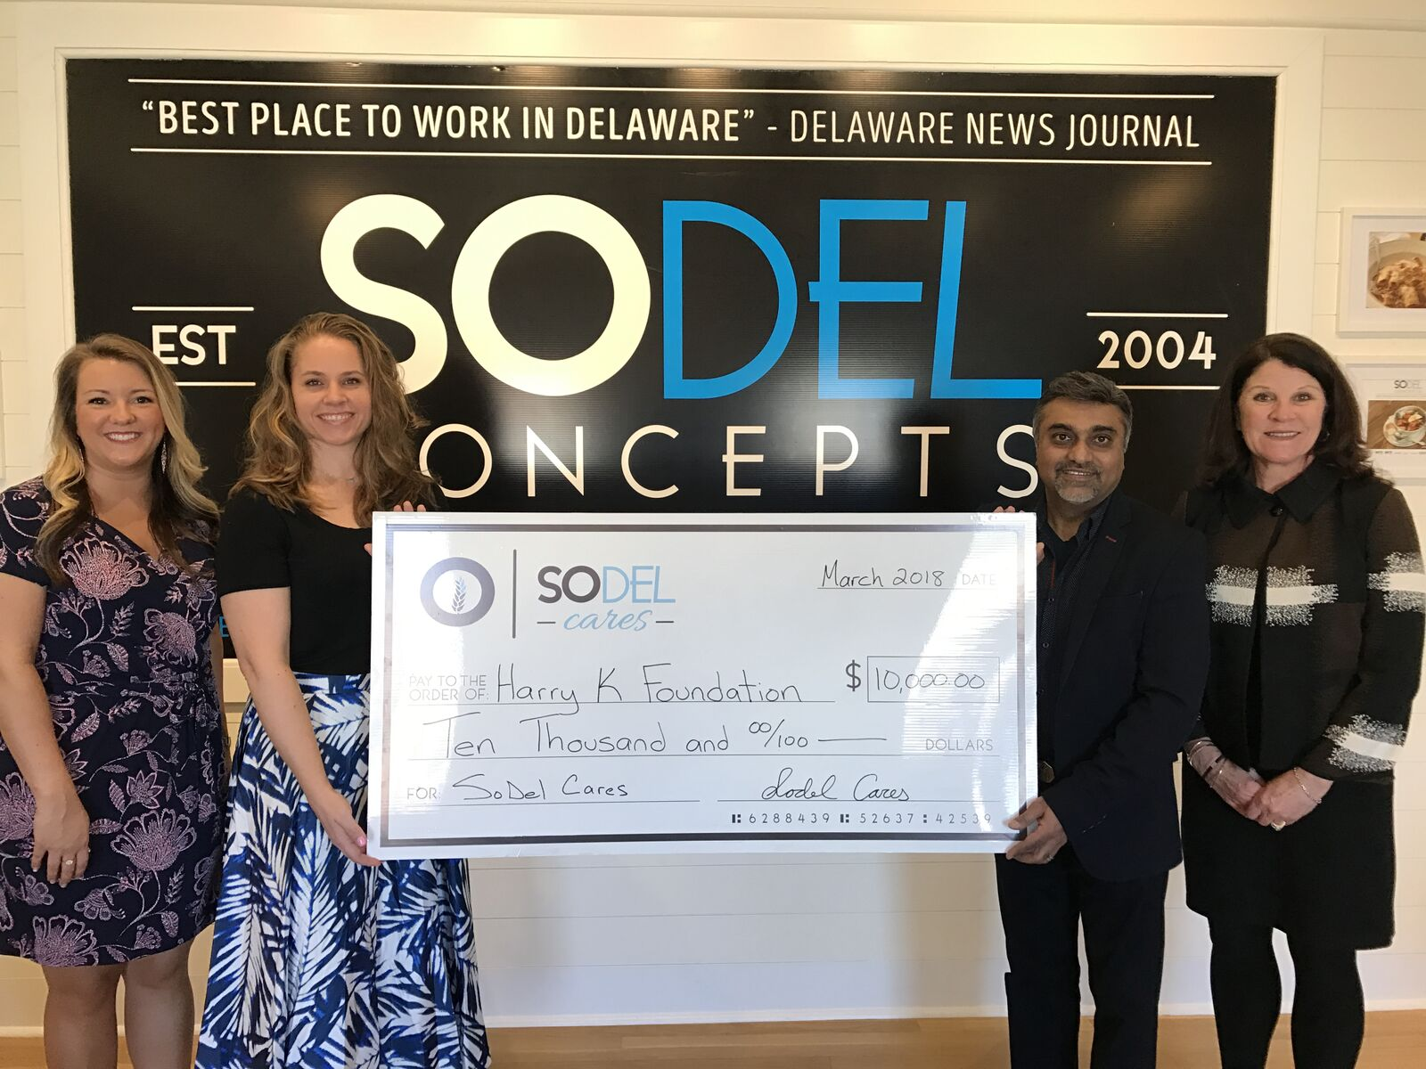

Slide 25
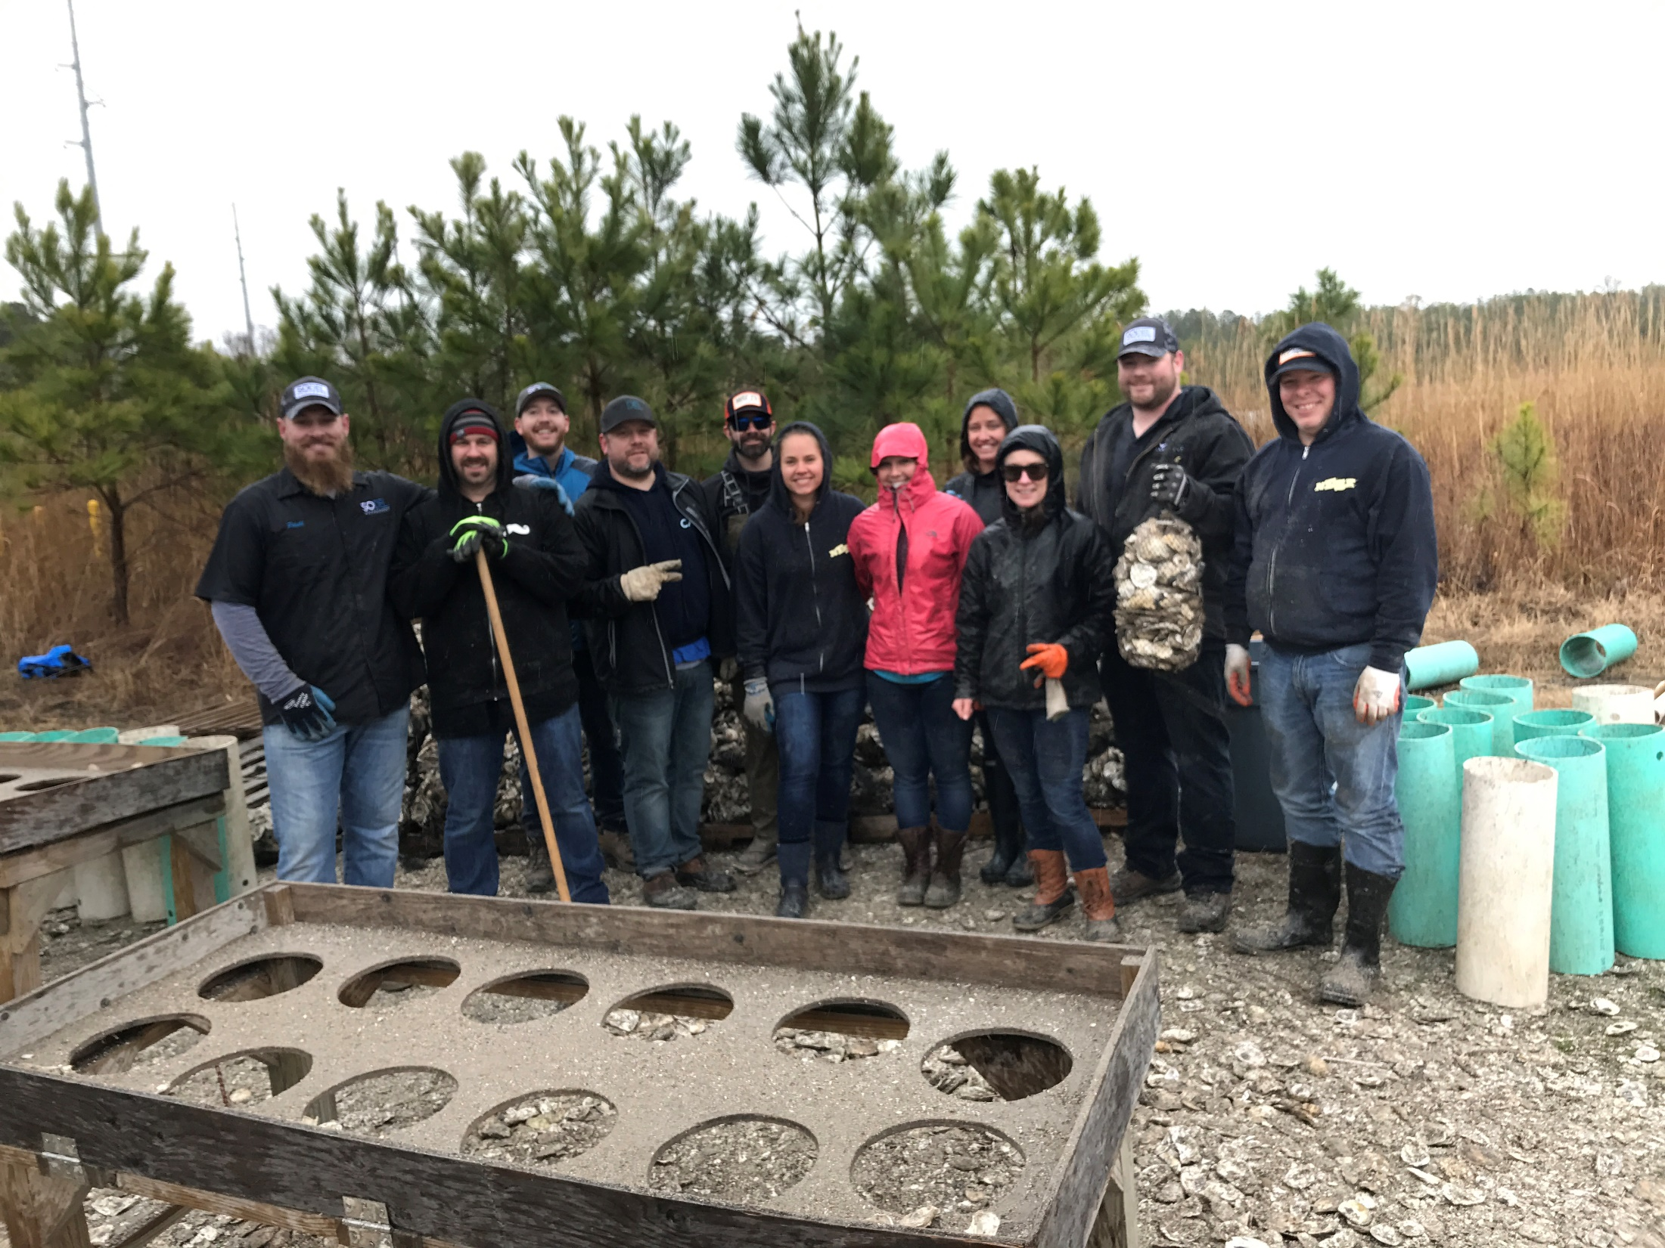

Slide 26
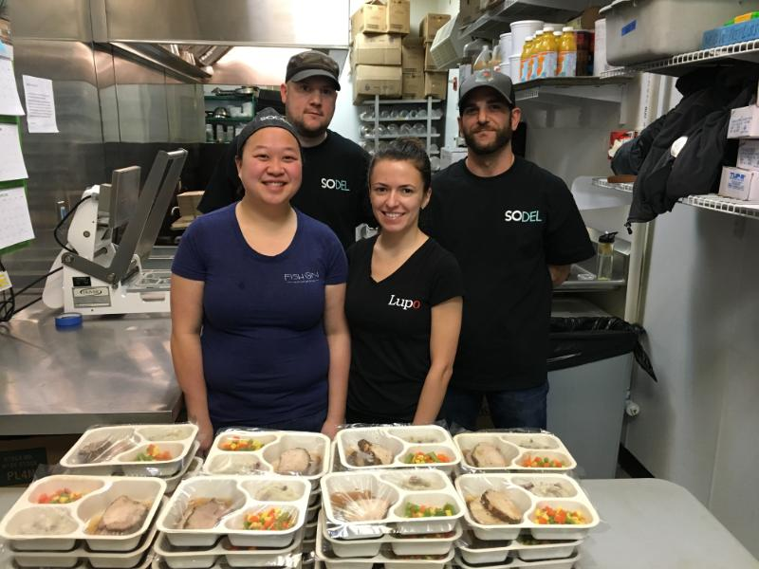
SoDel Concepts Partners with Meals on Wheels Lewes-Rehoboth to Feed Hundreds
May 23, 2016 | Posted by Lauren Holloway | DelmarvaLife
It’s a partnership that has been around since October 2014.
In 2014, Meals on Wheels Lewes-Rehoboth was actively seeking a contracted caterer. After several months and no luck, the organization crossed paths with the late Delaware restaurateur Matt Haley of SoDel Concepts.
“Matt Haley just said, ‘We’ll make it happen, we’ll make it happen,’ and that was the kind of attitude he had,” Katie Leister, volunteer coordinator for Meals on Wheels Lewes-Rehoboth, said. “He converted part of the Fish On kitchen to be able to prepare hundreds of meals. He was incredibly accommodating and said ‘I want to do this for the community.'”

Slide 27
DECAP Program
Putting it all together
(Beautiful Simple Food, Developing our People, Giving Back to our Communities)
and partnering with the DRA and the
DDOL

Slide 28
DECAP Program- A Partnership DDOL, DRA, SoDel Concepts

Slide 29
DECAP LAUNCH!

Slide 30
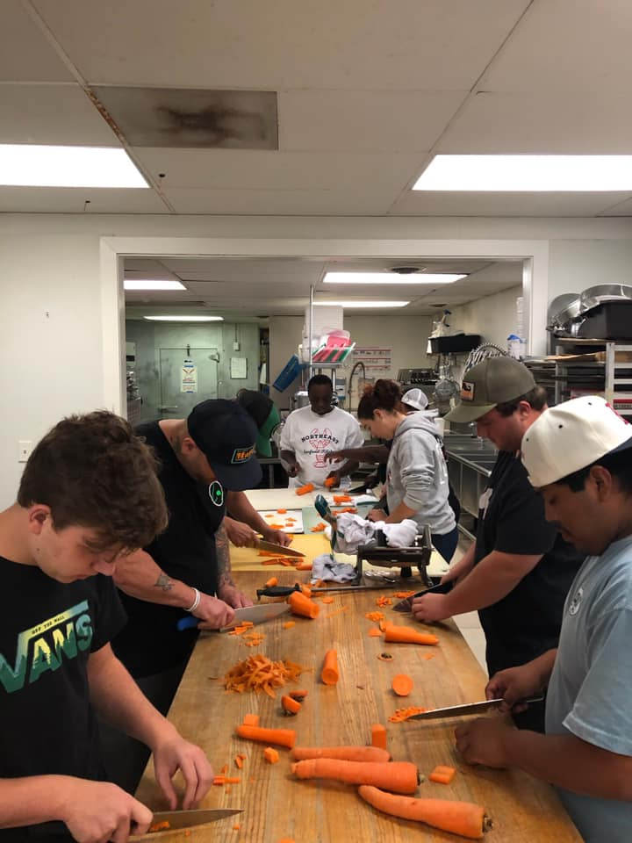
Training Begins Knife Skills 101

Slide 31
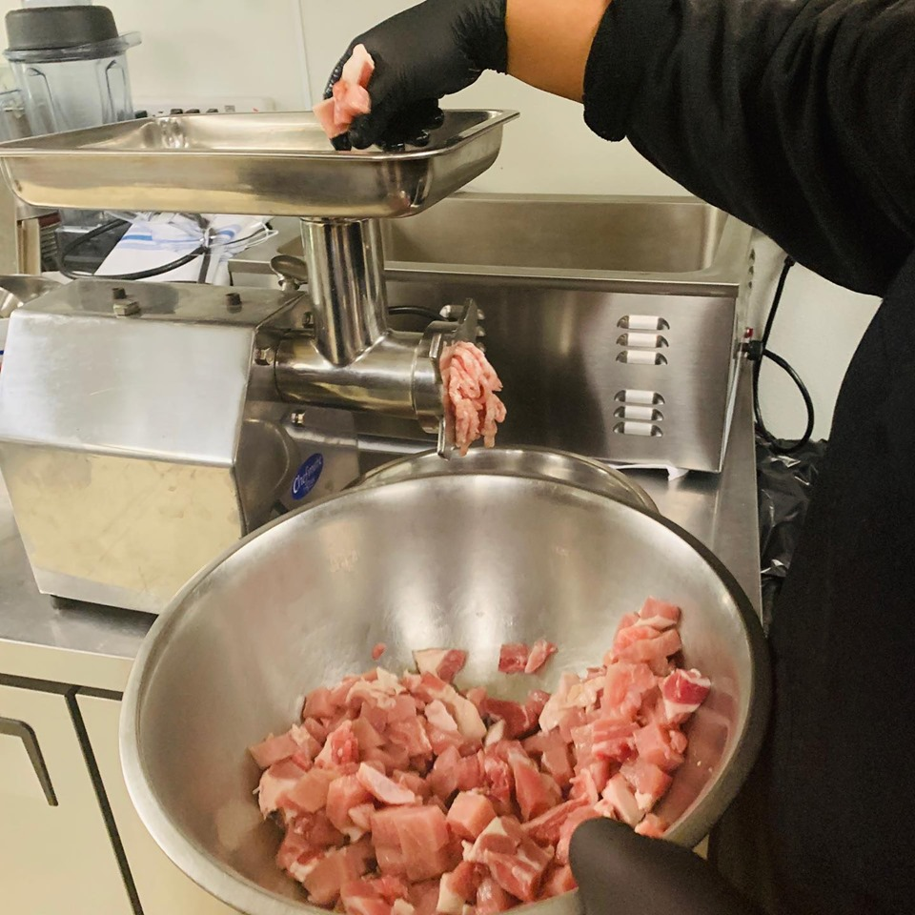
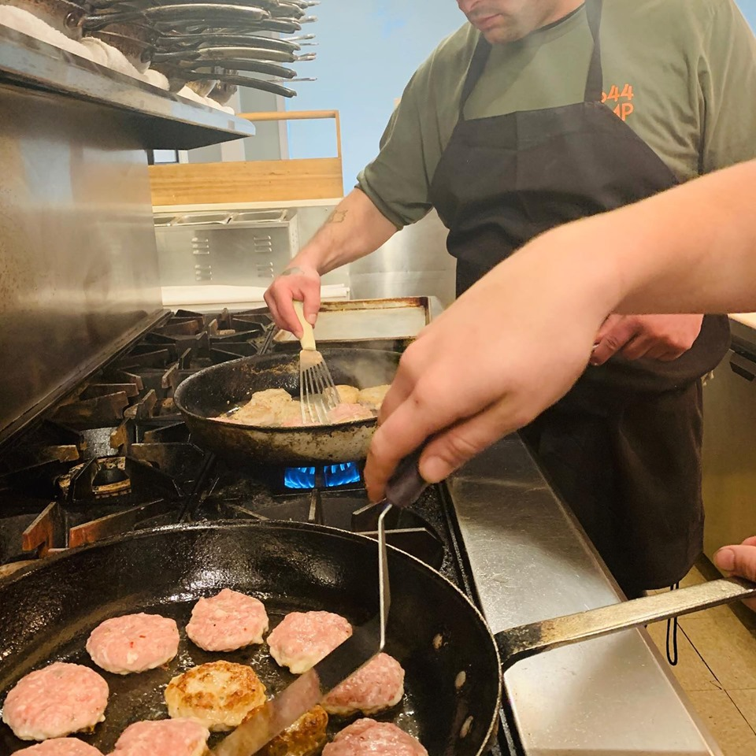
Importance of Scratch Cooking Fresh Ingredients

Slide 32
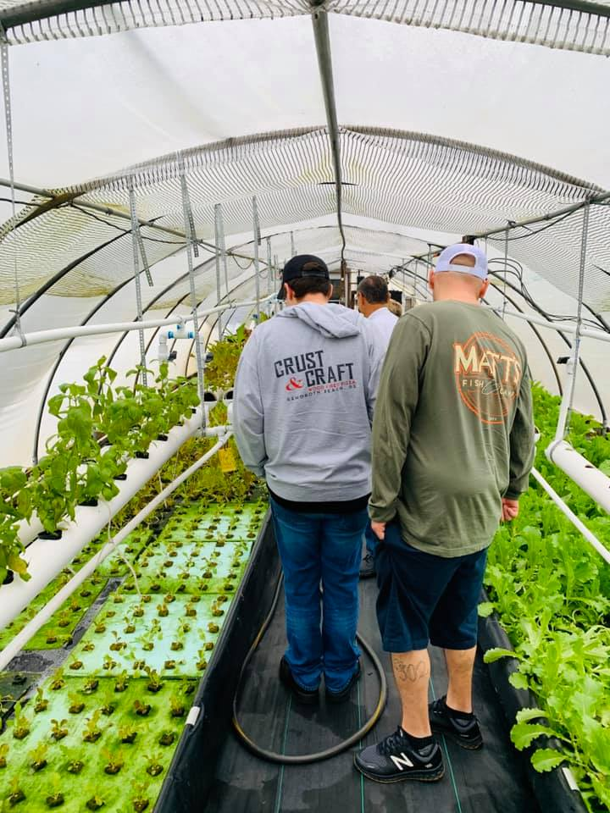
Field Trip! Importance of Knowing Local Farms & Using Locally Sourced Ingredients

Slide 33
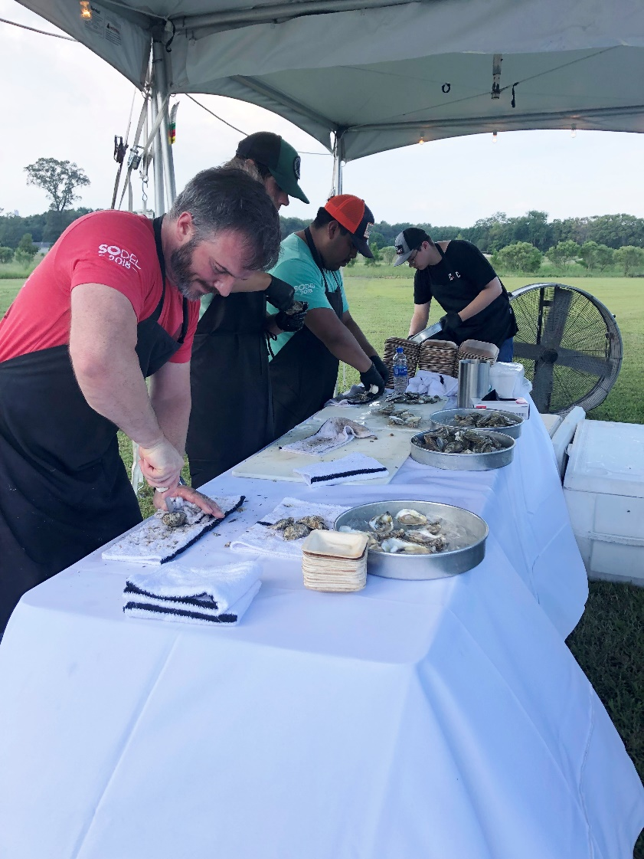
Farm to Table On Site at the Botanic Gardens

